Slide 1


The Group Chorale
By Maxim, Martin, George and Callum

Slide 2
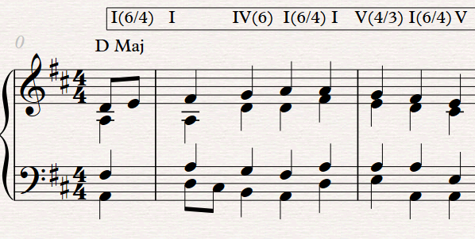
Maxim’s Sweet Start

Slide 3
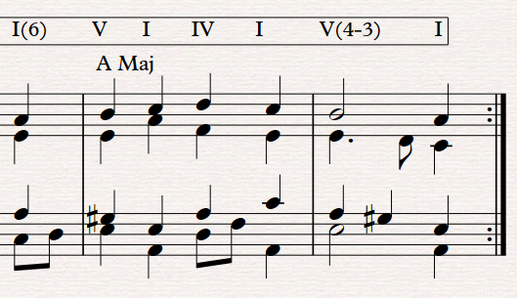
George’s Magnificent Modulation

Slide 4
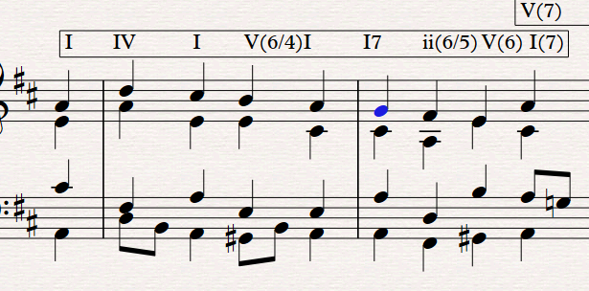
Martin’s Turnaround Cadence

Slide 5
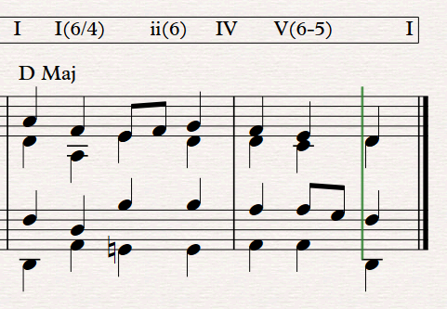
Callum’s Ecstatic Ending

Slide 6

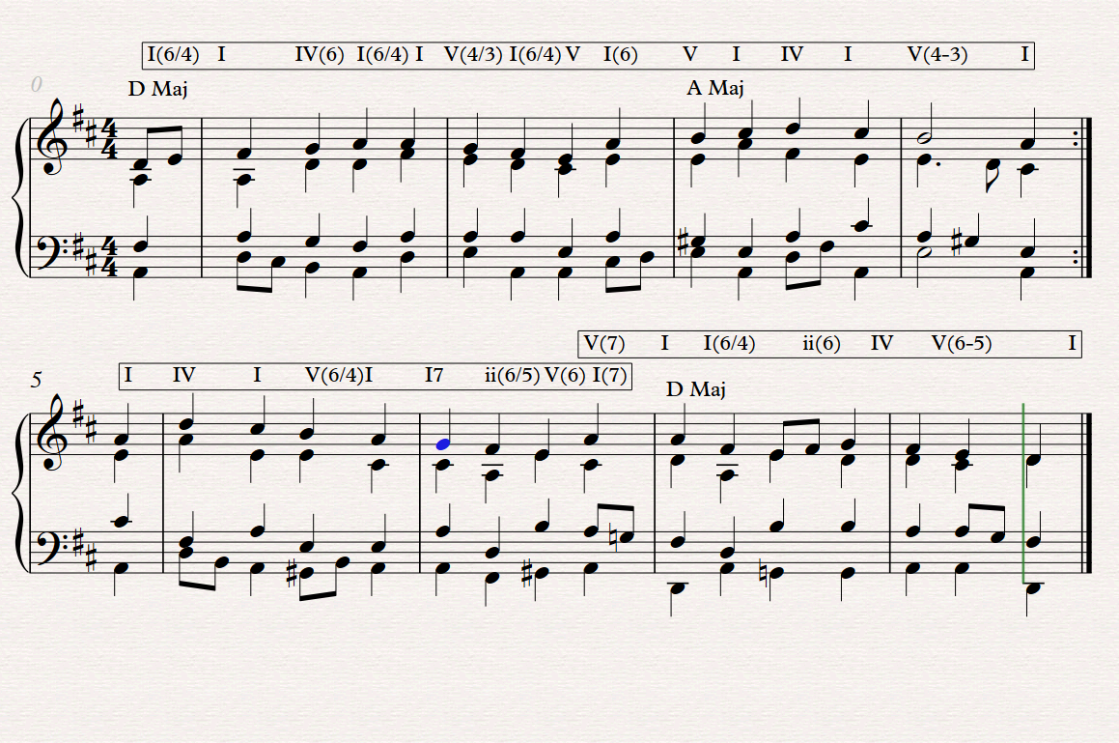
The WHOLE THING
Yeah, basically Bach’s brothers..

